Slide 1

Client Server Application
Working with necessary tools to create a Client Server Application
Presenter : Muresan Vlad

Slide 2
Agenda
How I see this experience
About the people I met
What I learned
Client Server Application

Slide 3

How I see this experience

Slide 4
This experience was a great opportunity to improve my teamwork, my programming skills and a chance to learn how a project is done
How I see this experience
These weeks I saw
how the IT industry works,
the level of knowledge required
that people in this field are dedicated

Slide 5
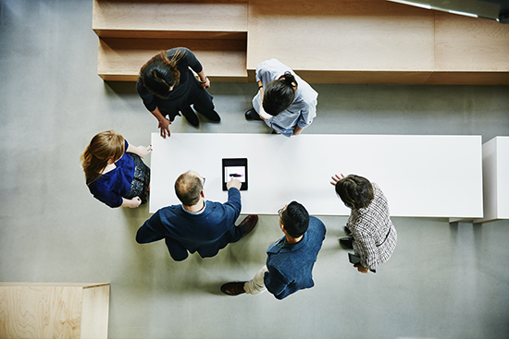
About the people I met

Slide 6
About the people I met
I can say that the people I met showed professionalism
I was impressed by the involvement of the people I interacted with
The general impression is that this is a healthy environment

Slide 7

What I learned

Slide 8
WSL(Windows Subsystem for Linux)-used to run a Linux environment on Windows Git-used to track changes in files Cram-used to test the application Vim-text editor used to create or edit text
What I learned

Slide 9

Client Server Application

Slide 10
Client Server Application
How the application works:
The server parses an xml file and waits for connections
The client is trying to connect to the server
If the connection is established, the client receives the information extracted from the xml file by the server
The client creates a new xml file with the information received from the server
Steps 3 and 4 are repeated every time a client connects

Slide 11
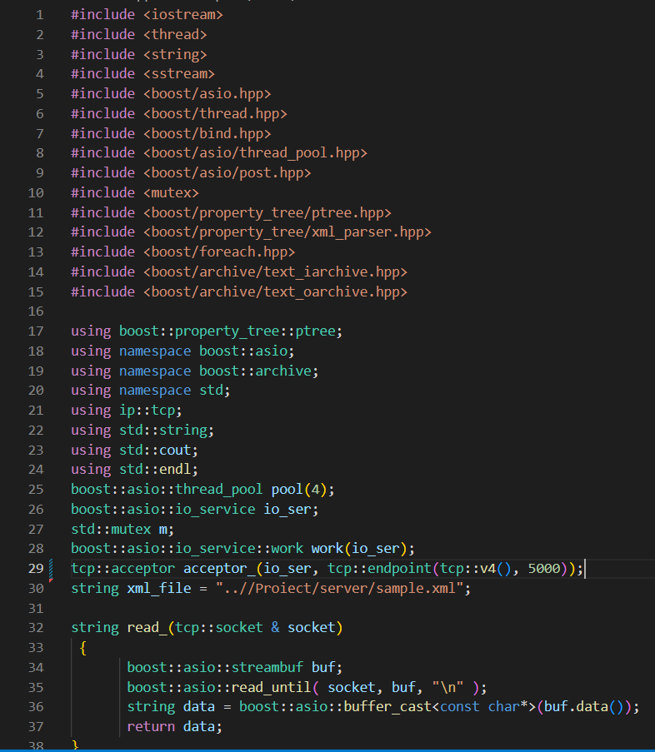
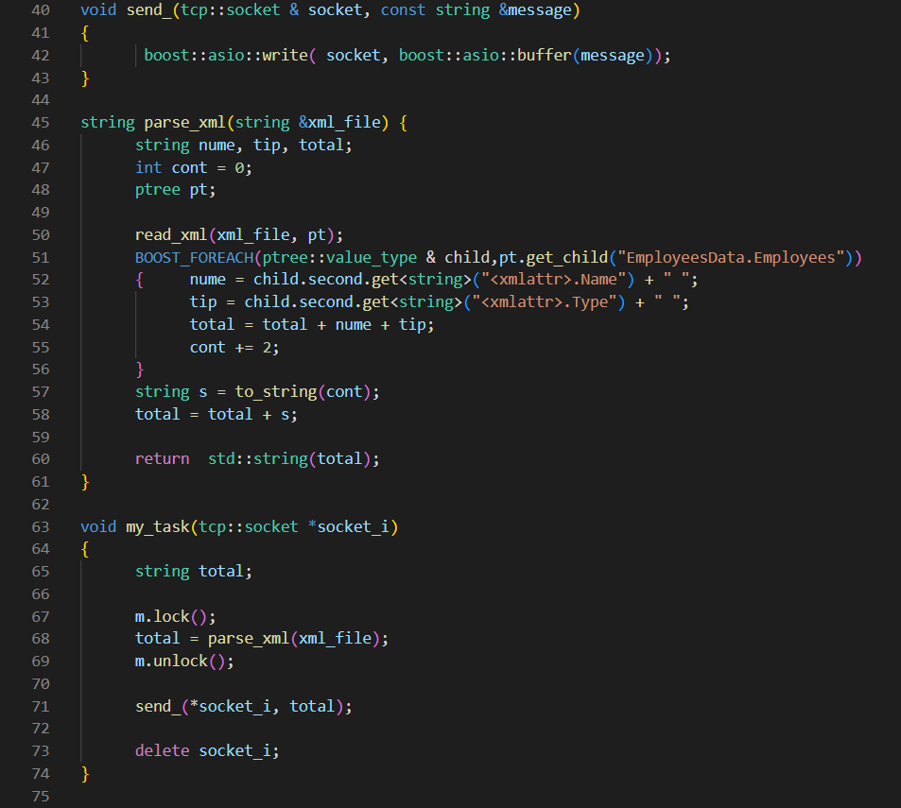
Server code
Functions

Slide 12
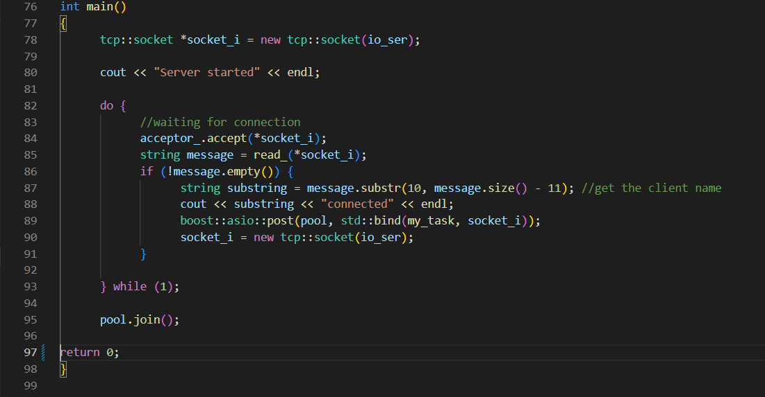
Server code
In main

Slide 13
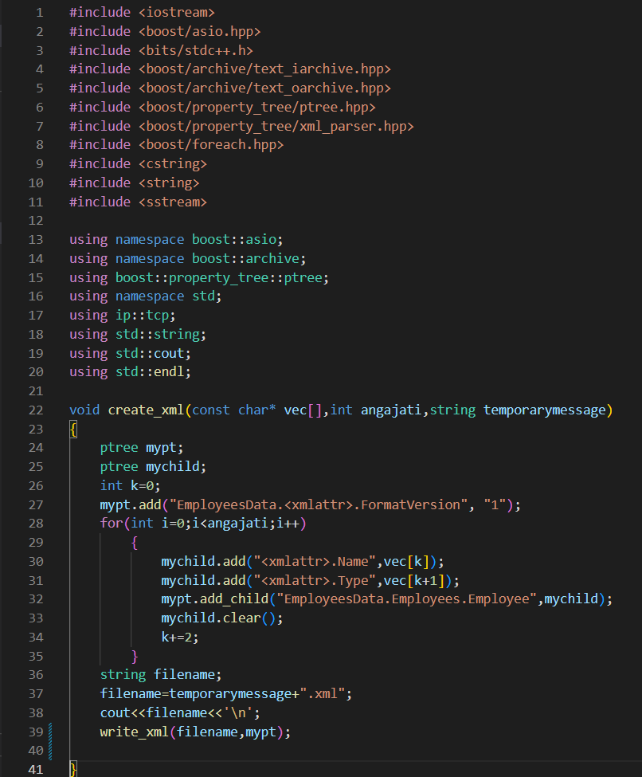
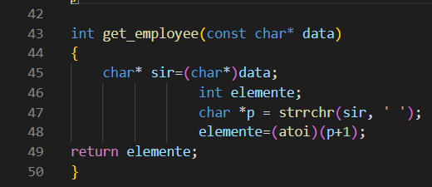
Client code
Functions

Slide 14
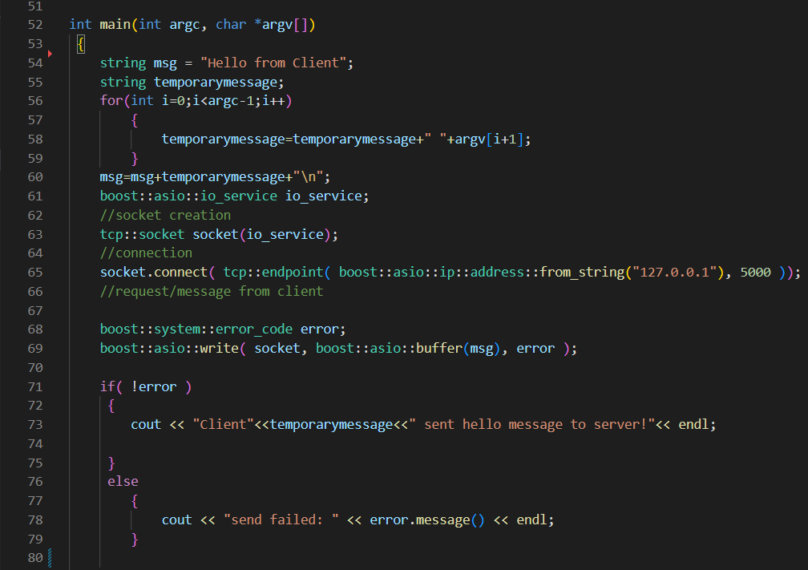
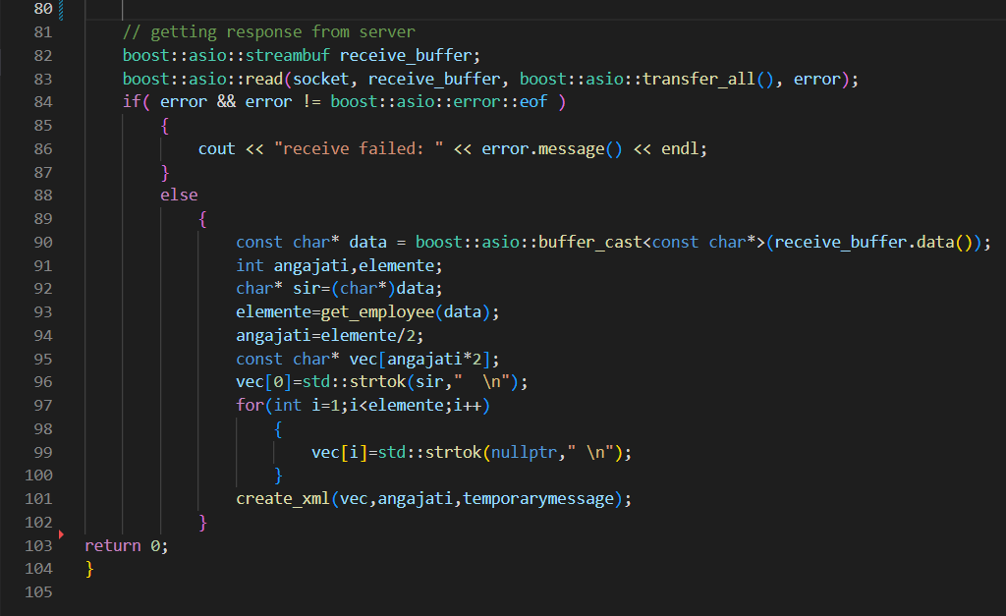
Client code
In main

Slide 15
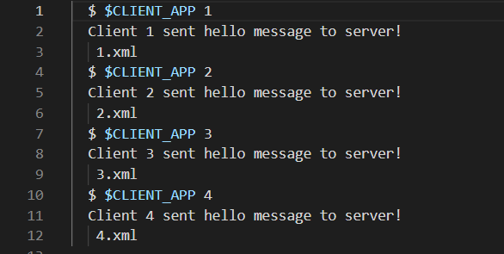
Cram test

Slide 16
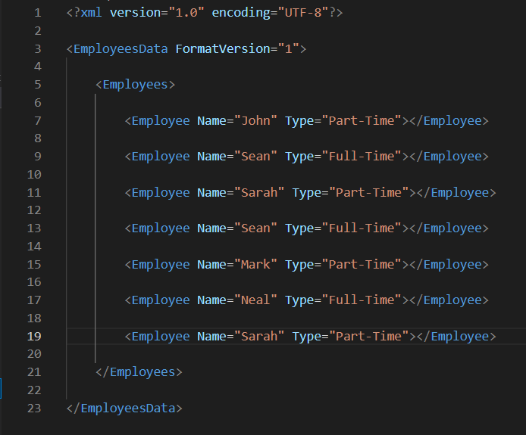
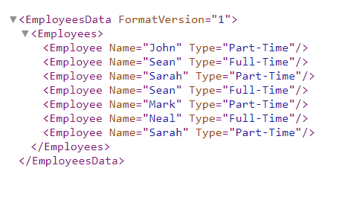
XML FILE
Input XML (Server)
Output XML(Client)

Slide 17
In conclusion, this experience was an opportunity to improve my skills and meet new people

Slide 18
Q&A

Slide 19
Thank You

